Slide 1
Persistent Environments with
Run:ai
(using conda/mamba & Jupyter)

Slide 2
Background

Slide 3
A (specific) frequently asked question
Client
Ok so I think I get Docker and how it works with Run:ai… but… does this mean I have to make a Docker image for EVERY single one of my conda environments??
Answer: Yes!
Run:ai
Well, that would be the preferred way to do things.
Client
Is there a way I can create and save environments on-the-fly, like I do in my normal workflow?

Slide 4
Solution

Slide 5
How do we do this?
(Image)
Conda background
When conda is installed, it creates a directory to keep its files.
Whenever a conda environment is created, it is saved inside a directory called “envs,” within the conda directory.
conda
envs
The idea
Create a folder called “envs” in your NFS
Mount the NFS “envs” folder, to the location of the conda environments folder in your image.
(Image)
(your NFS)
conda
envs
envs

Slide 6
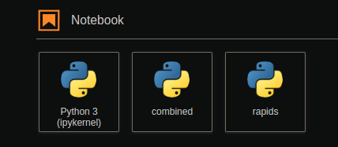
A note on Jupyter
Many users like to have ‘tiles’ for their environment on Jupyter
(Image)
These setting are saved in a folder called ‘kernels’
kernels
Adding a tile is done with the following sequence of commands, then refreshing the web browser
We can persist these ‘tiles’ by:
Creating a folder called “kernels” in your NFS
Mounting the NFS “kernels” folder, to the location of the kernels folder in your image.
mamba create -n {your-env-name} ipykernel {your-env-libs}
conda activate {your-env-name}
python -m ipykernel install --user --name={your-env-name}
(your NFS)
(Image)
(If you want to remove the ‘tile’, this command is used)
kernels
kernels
jupyter kernelspec uninstall {your-env-name}

Slide 7
Docker image
The docker image that we will be using throughout this notebook is:
jonathancosme/base-notebook-root*
It is a slightly modified version of the jupyter/base-notebook
image
You can find more information about jonathancosme/base-notebook-root here:
https://github.com/jonathancosme/jupyter-base-notebook-root
*Please note that all our Jupyter images are based off the official Jupyter Docker images. The official images do not have root privileges by default. In order to successfully mount to the ‘kernels’ and ‘envs’ folders in the Jupyter Lab, root privileges are required. We created a custom image that runs root by default. You can see how our image differs from the official image on the github.

Slide 8
Steps

Slide 9
Steps
Create ‘envs’ and ‘kernels’ folder in our NFS
Mount NFS ‘envs’ and ‘kernels’ folders on an interactive Jupyter lab job
Create your environment
Test the environment

Slide 10
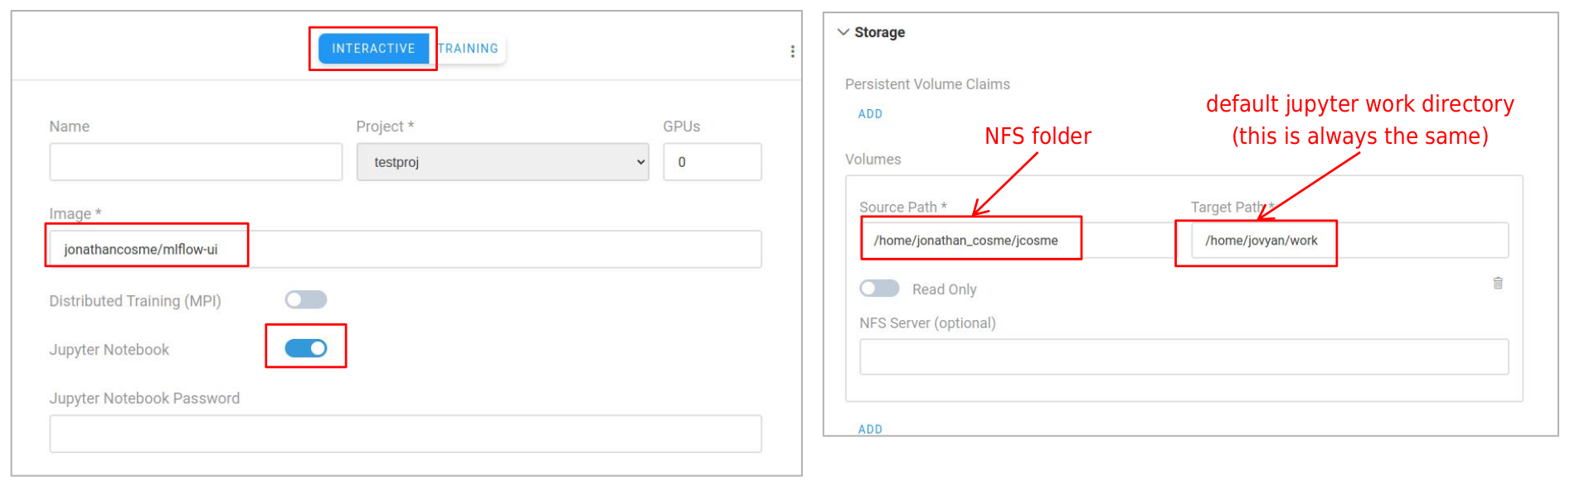
Step 1
Create ‘envs’ and ‘kernels’ folder in our NFS
1.1 Start a Jupyter Lab interactive session, mounting your NFS folder to /home/jovyan/work
jupyter/base-notebook
/home/jonathan_cosme/jcosme
/home/jovyan/work

Slide 11
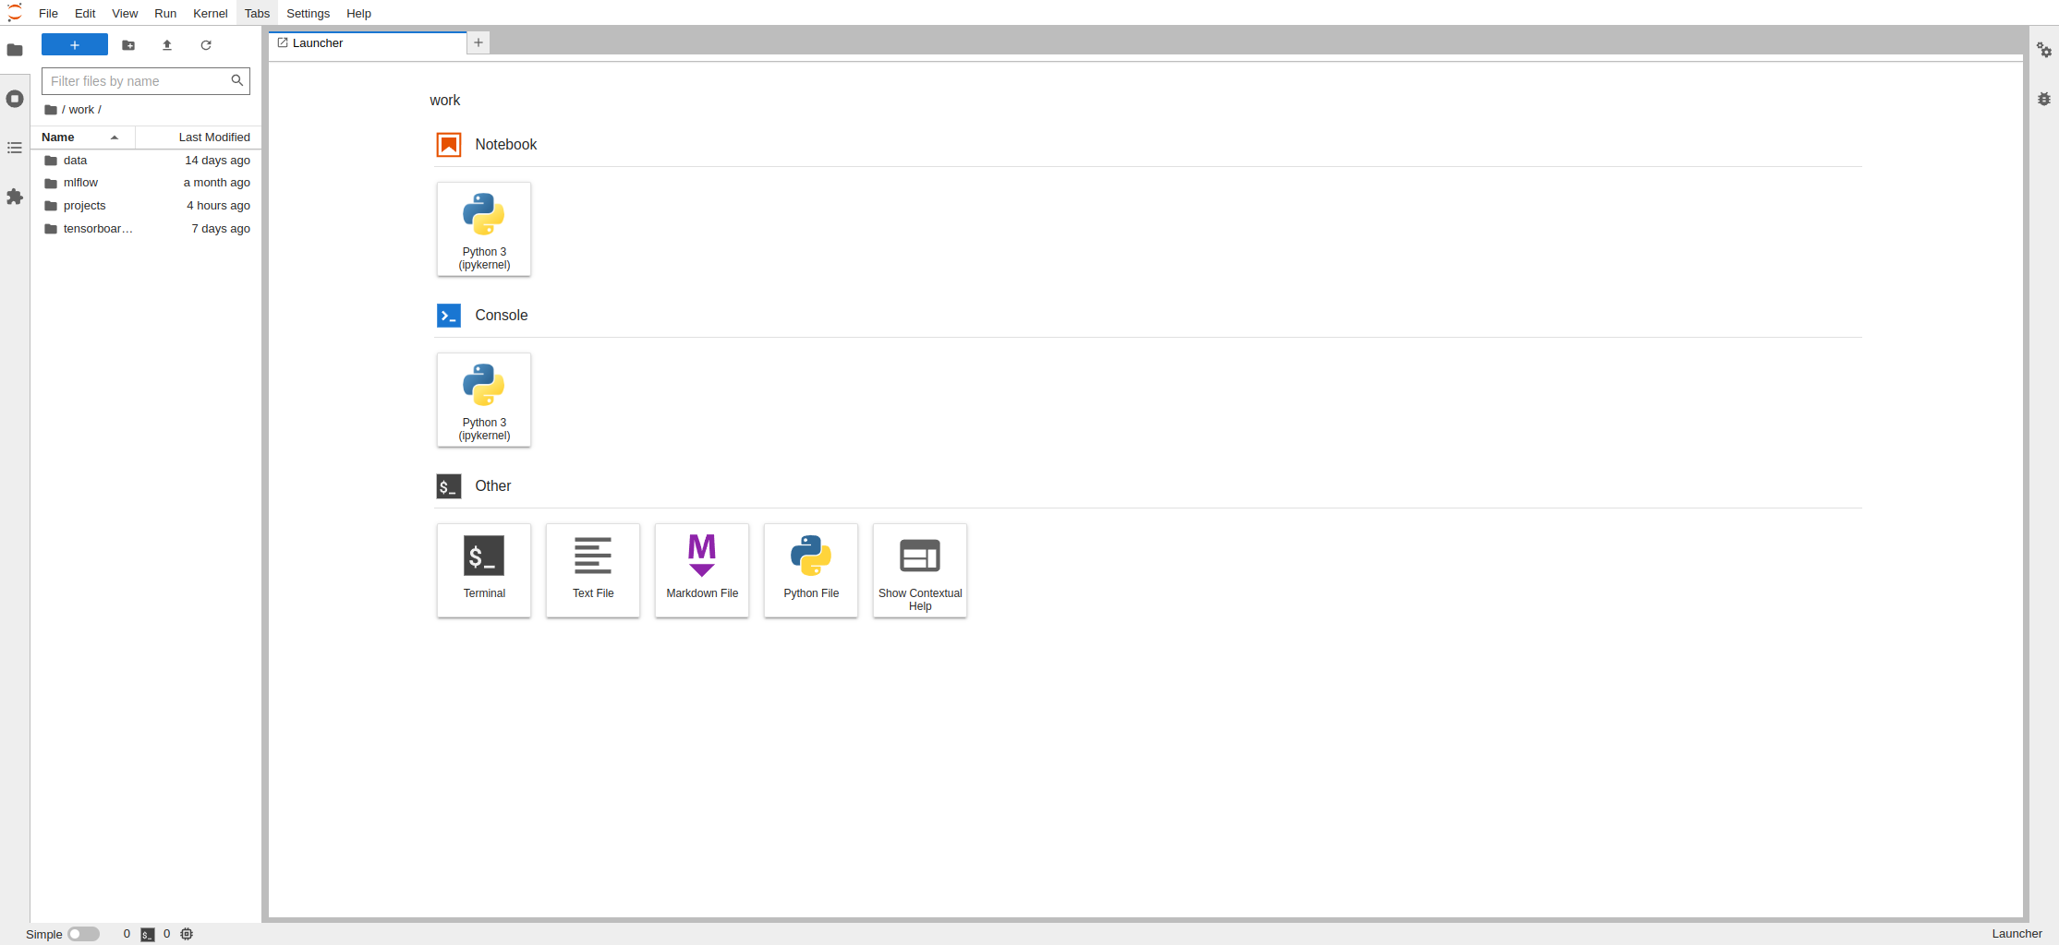
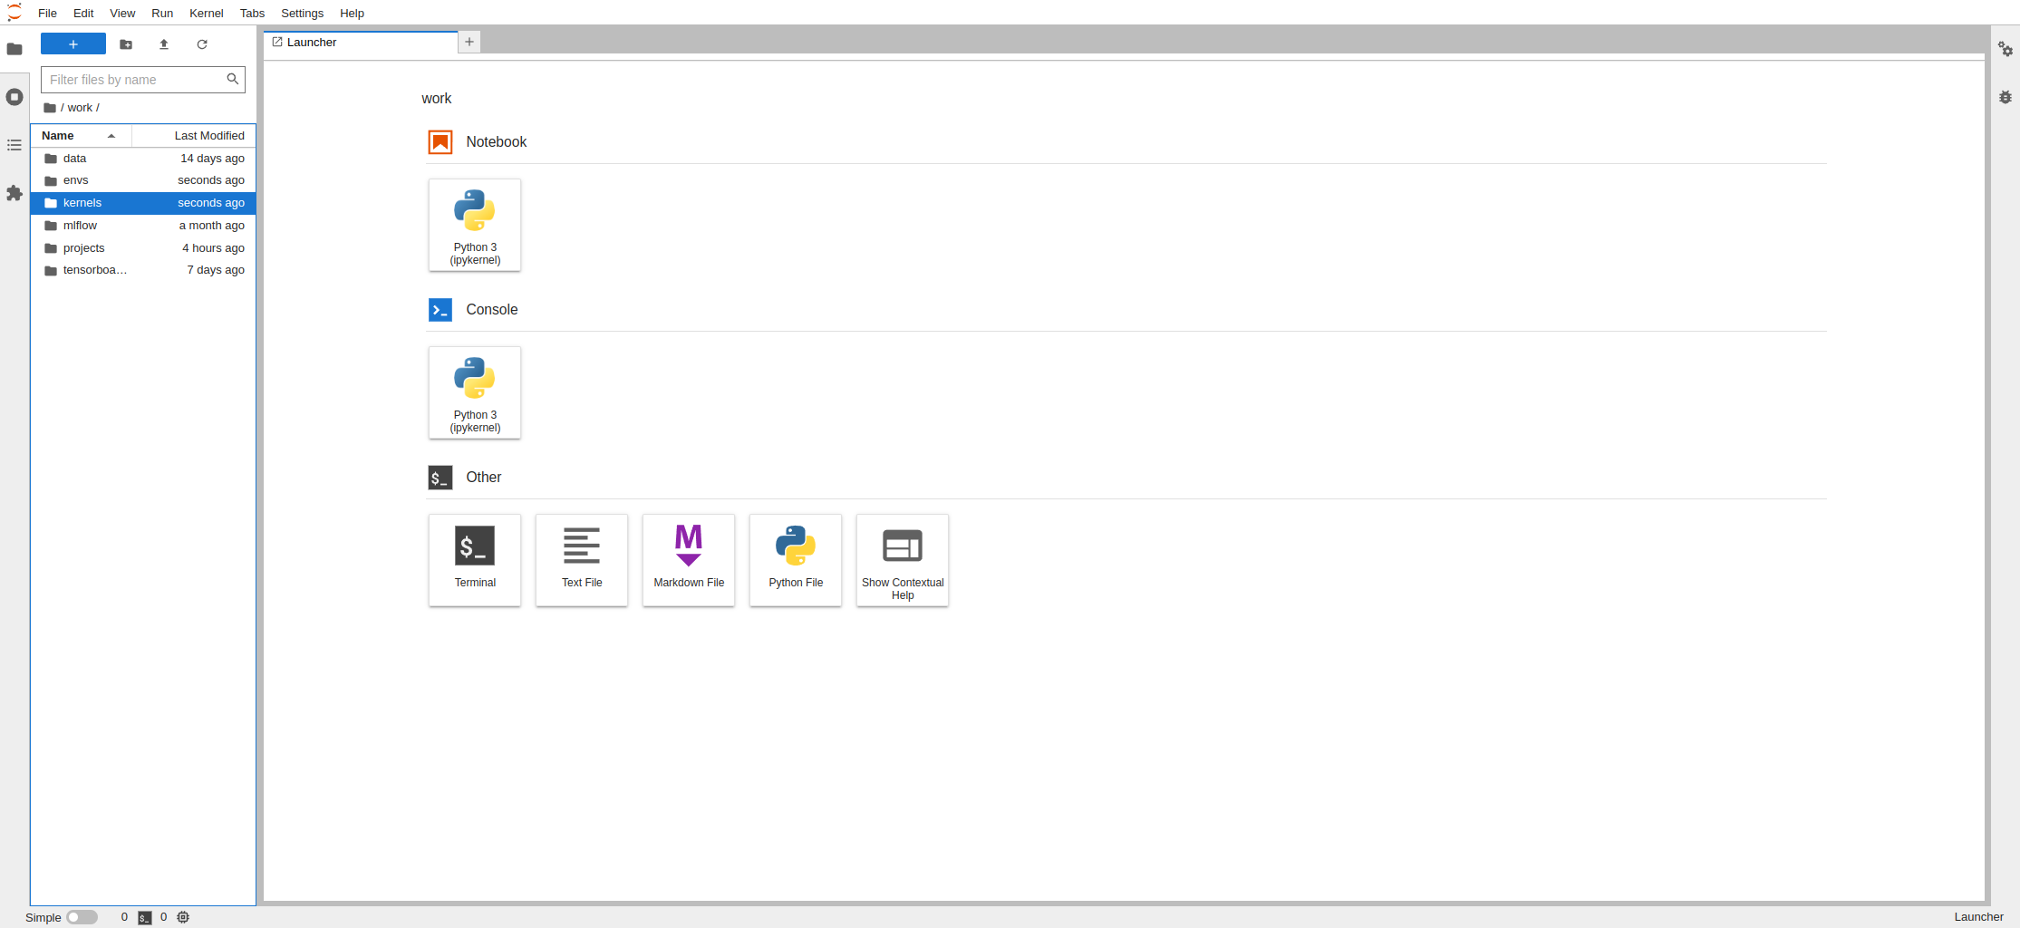
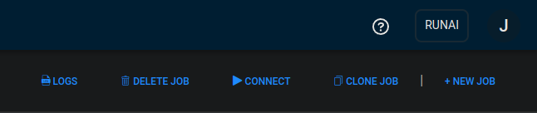
Step 1
Create ‘envs’ and ‘kernels’ folder in our NFS
1.2 Navigate to the ‘work’ directory. You should see your files/folders inside.
1.3 Select the new folder icon, twice (to create two new folders)
1.4 Rename the folders ‘envs’ and ‘kernels’
1.5 Delete the job

Slide 12
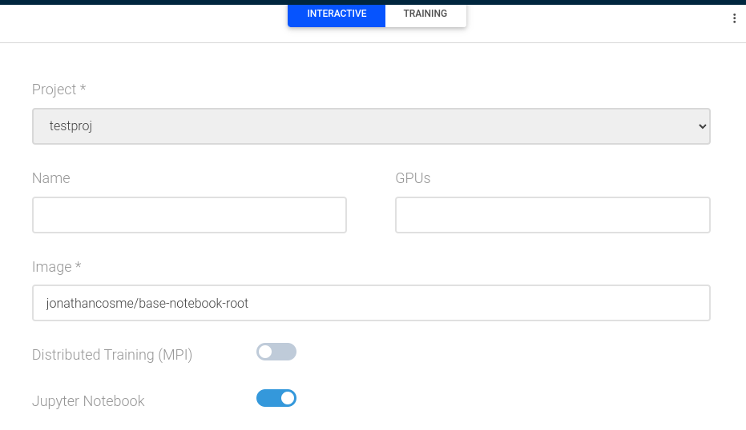
Step 2
Mount NFS ‘envs’ and ‘kernels’ folders on an interactive Jupyter lab job
2.1 Start a Jupyter Lab interactive session using the image jonathancosme/base-notebook-root (do NOT submit job yet)
jonathancosme/base-notebook-root

Slide 13
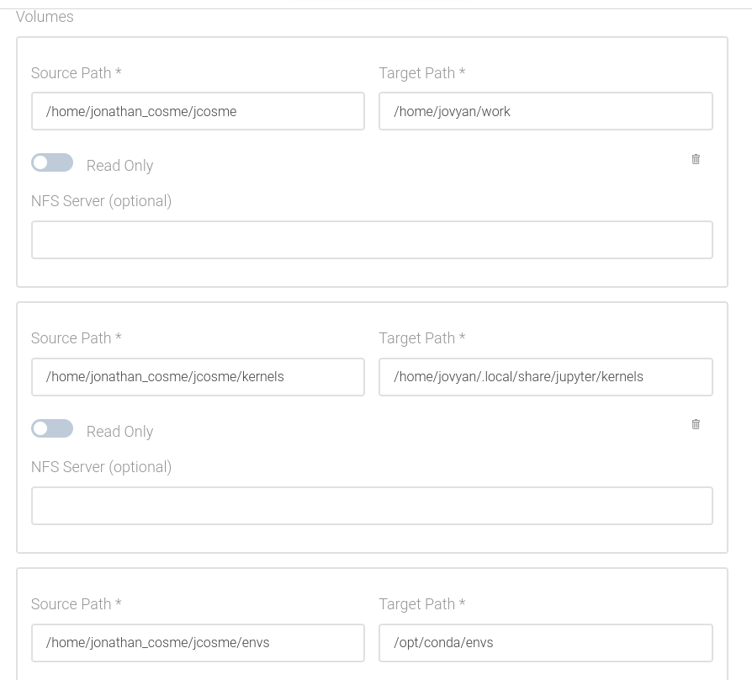
Step 2
Mount NFS ‘envs’ and ‘kernels’ folders on an interactive Jupyter lab job
2.2 mounts NFS to /home/jovyan/work
/home/jonathan_cosme/jcosme
/home/jovyan/work
2.3 mounts NFS ‘kernels’ folder to /home/jovyan/.local/share/jupyter/kernels
2.4 mounts NFS ‘envs’ folder to /opt/conda/envs
/home/jonathan_cosme/jcosme/kernels
/home/jovyan/.local/share/jupyter/kernels
2.5 Submit job
/home/jonathan_cosme/jcosme/envs
/opt/conda/envs

Slide 14
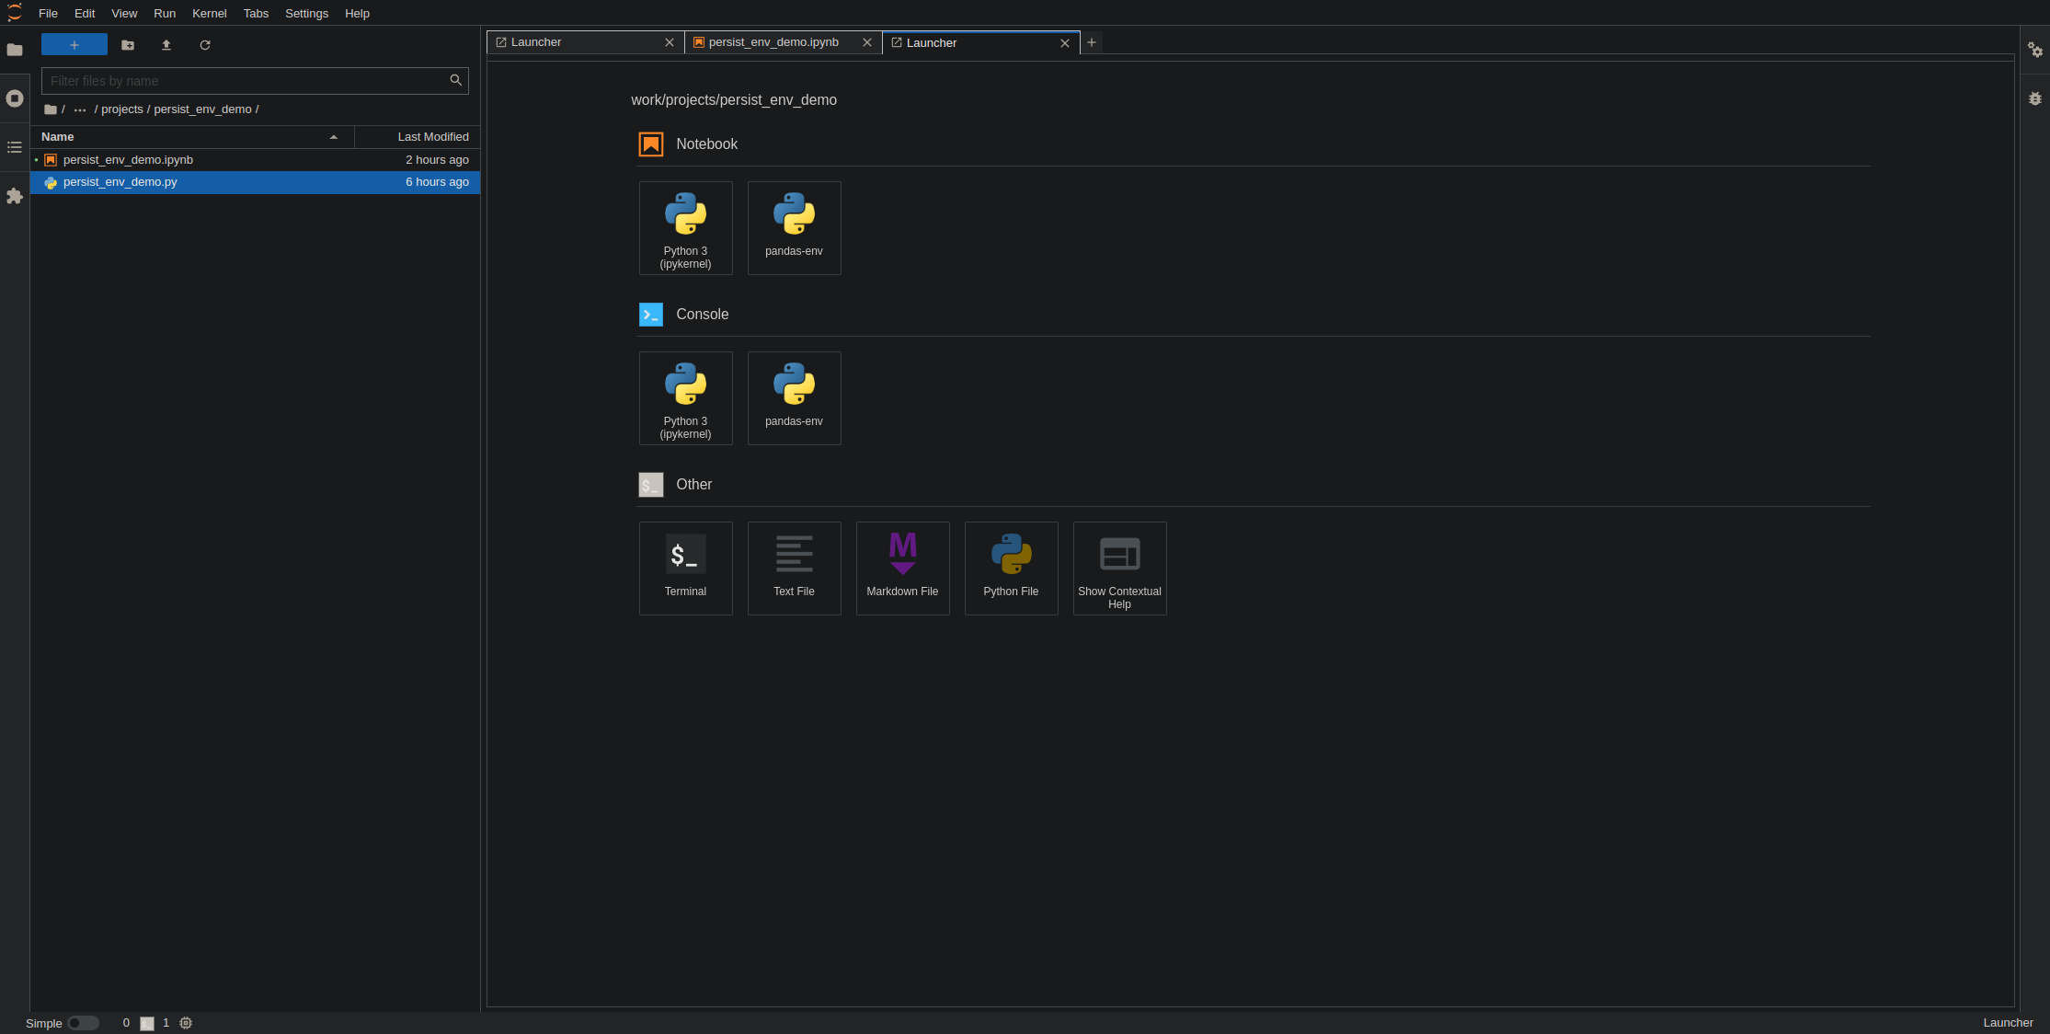
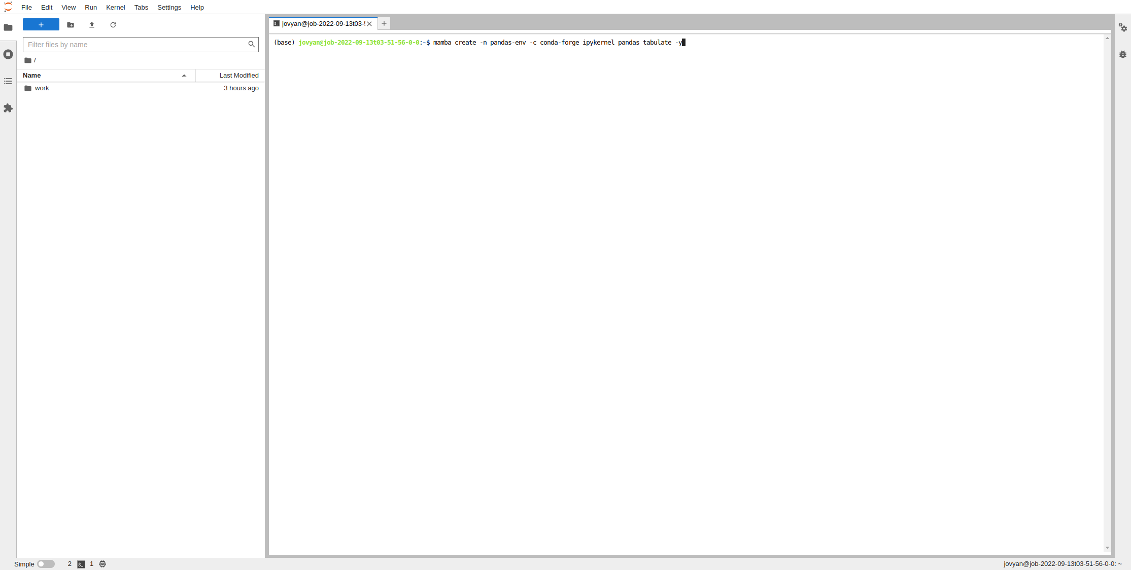
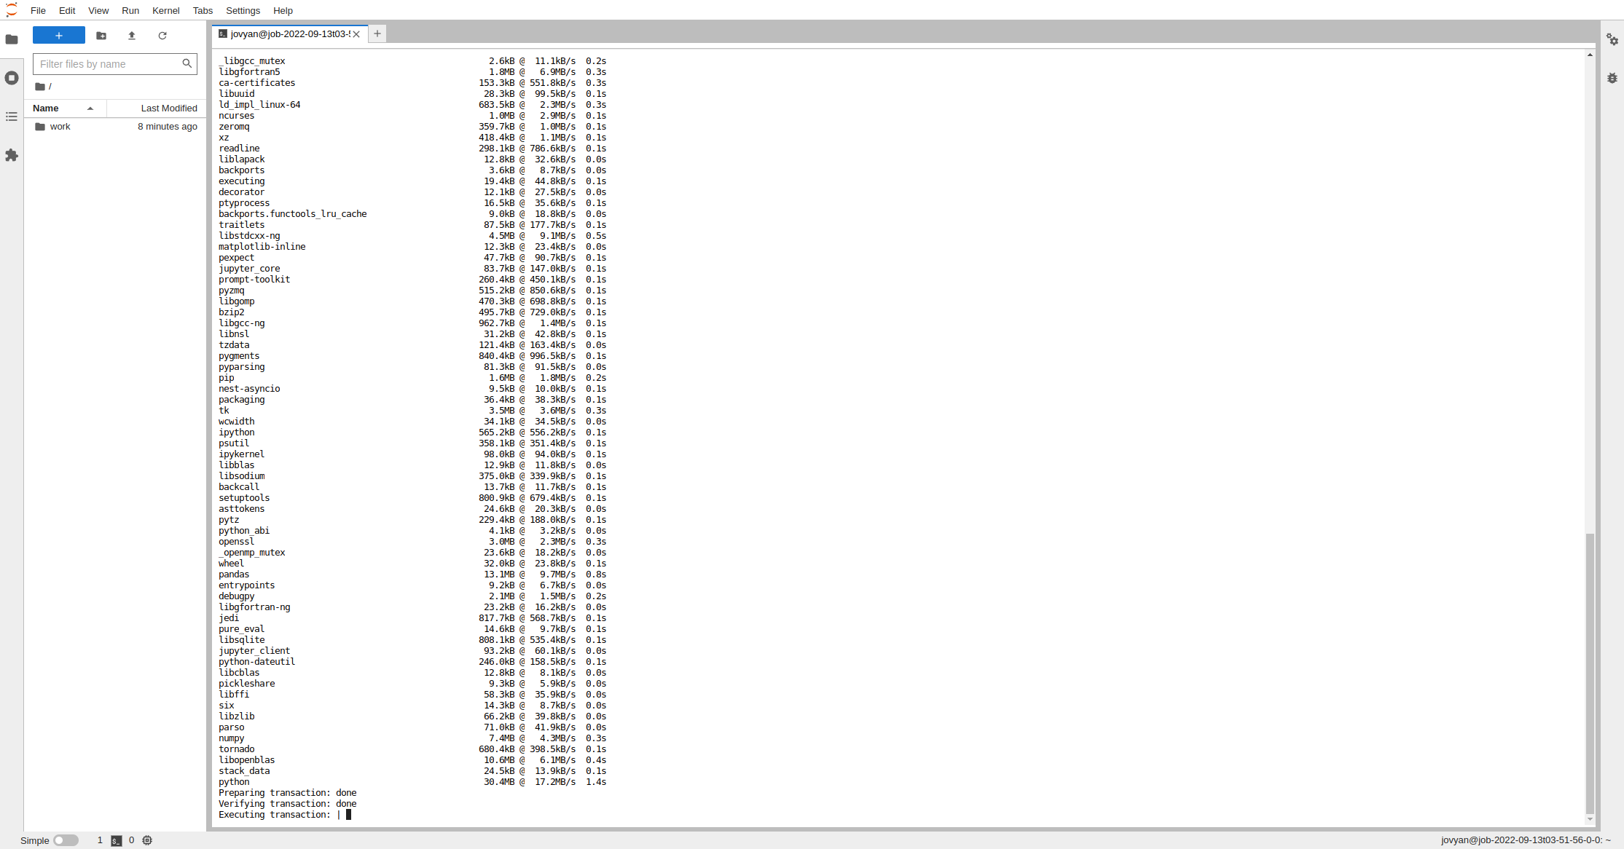
Step 3
Create your environment
3.1 start a terminal, after connecting to the Jupyter lab interactive job
3.2 create an environment using the following format (ipykernel must always be installed in an environment to create a tile)
mamba create -n {your-env-name} -c conda-forge ipykernel {your-env-libraries} -y
3.3 wait for environment to finish creating.
Warning: depending on your NFS speed, the ‘Executing transaction’ step can take a long time (~3 minutes for me)

Slide 15
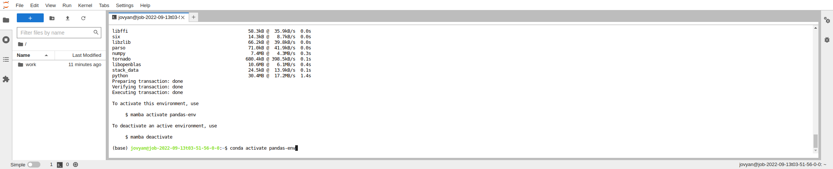
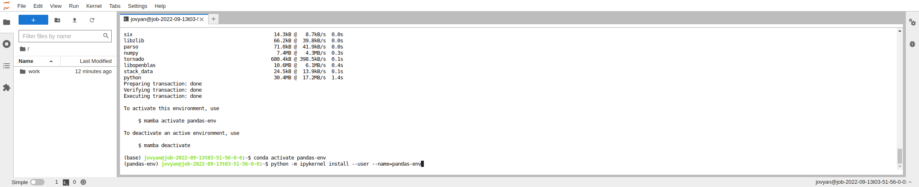
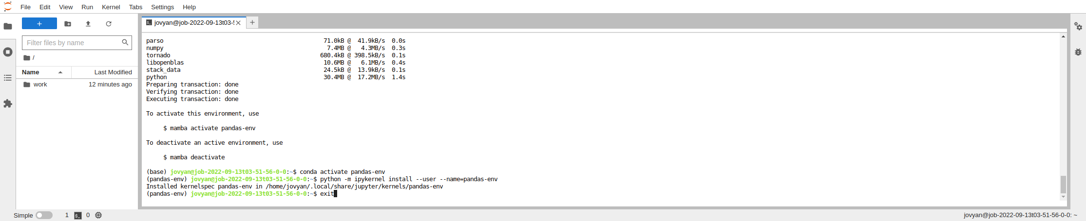
Step 3
Create your environment
3.4 activate the newly created environment using the following format
conda activate {your-env-name}
3.5 Create the tile by using the following format
Python -m ipykernel install --user --name={your-env-name}
3.6 exit the terminal with the following command
exit

Slide 16
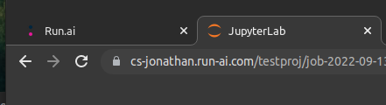
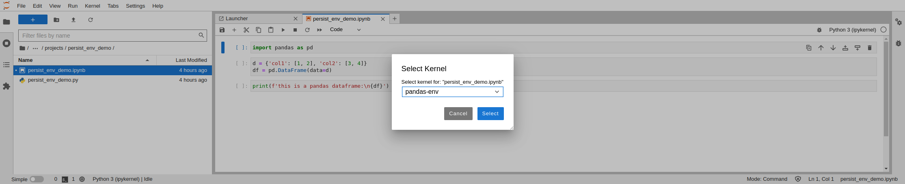
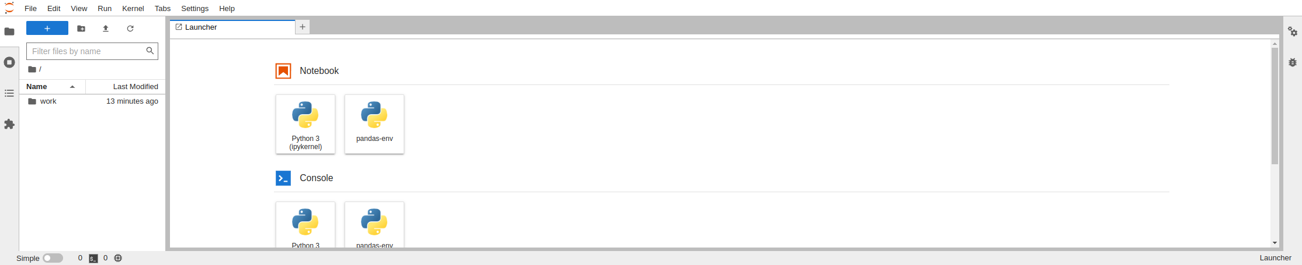
Step 3
Create your environment
3.7 Refresh the Jupyter Lab tab on your browser
3.9 You can also select the new env is notebooks
1
2
3.8 A tile for your new environment should now be visible
3

Slide 17
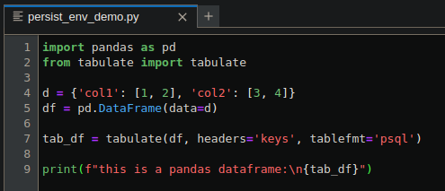
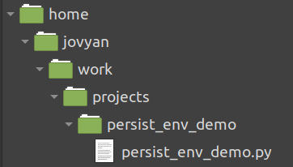
Step 4
Test the environment
Let’s assume I have this python script….
…located here (after mounting my NFS to the Jupyter Lab work directory)

Slide 18
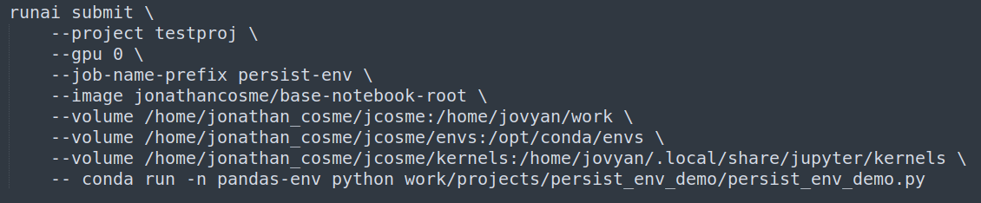
Step 4
Test the environment
This is the runai CLI command I want to run

Slide 19
Step 4
Test the environment
This is the runai CLI command I want to run
1
2
3
4
5
6
Use the image jonathancosme/base-notebook-root
Mount NFS to Jupyter work directory
Mount NFS ‘envs’ folder to Jupyter conda envs folder
Mount NFS ‘kernels’ folder to Jupyter kernels folder
Run our command (to follow) in the conda environment named ‘pandas-env’
Run our python script

Slide 20
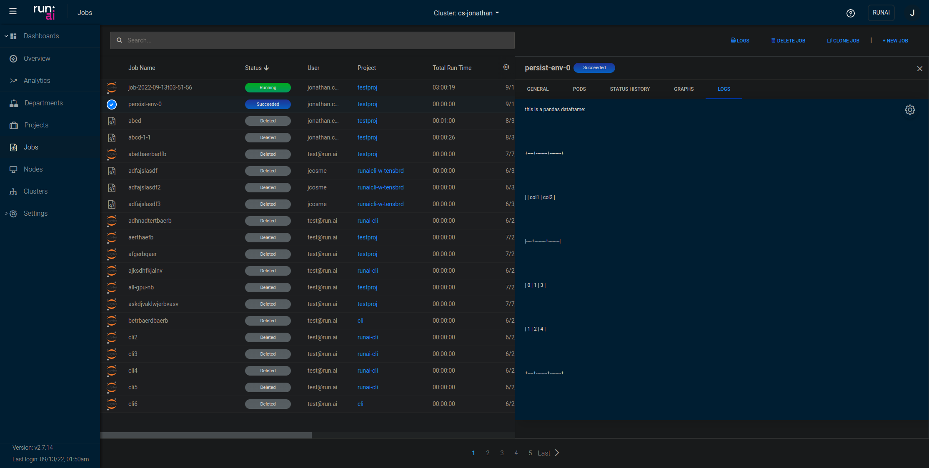
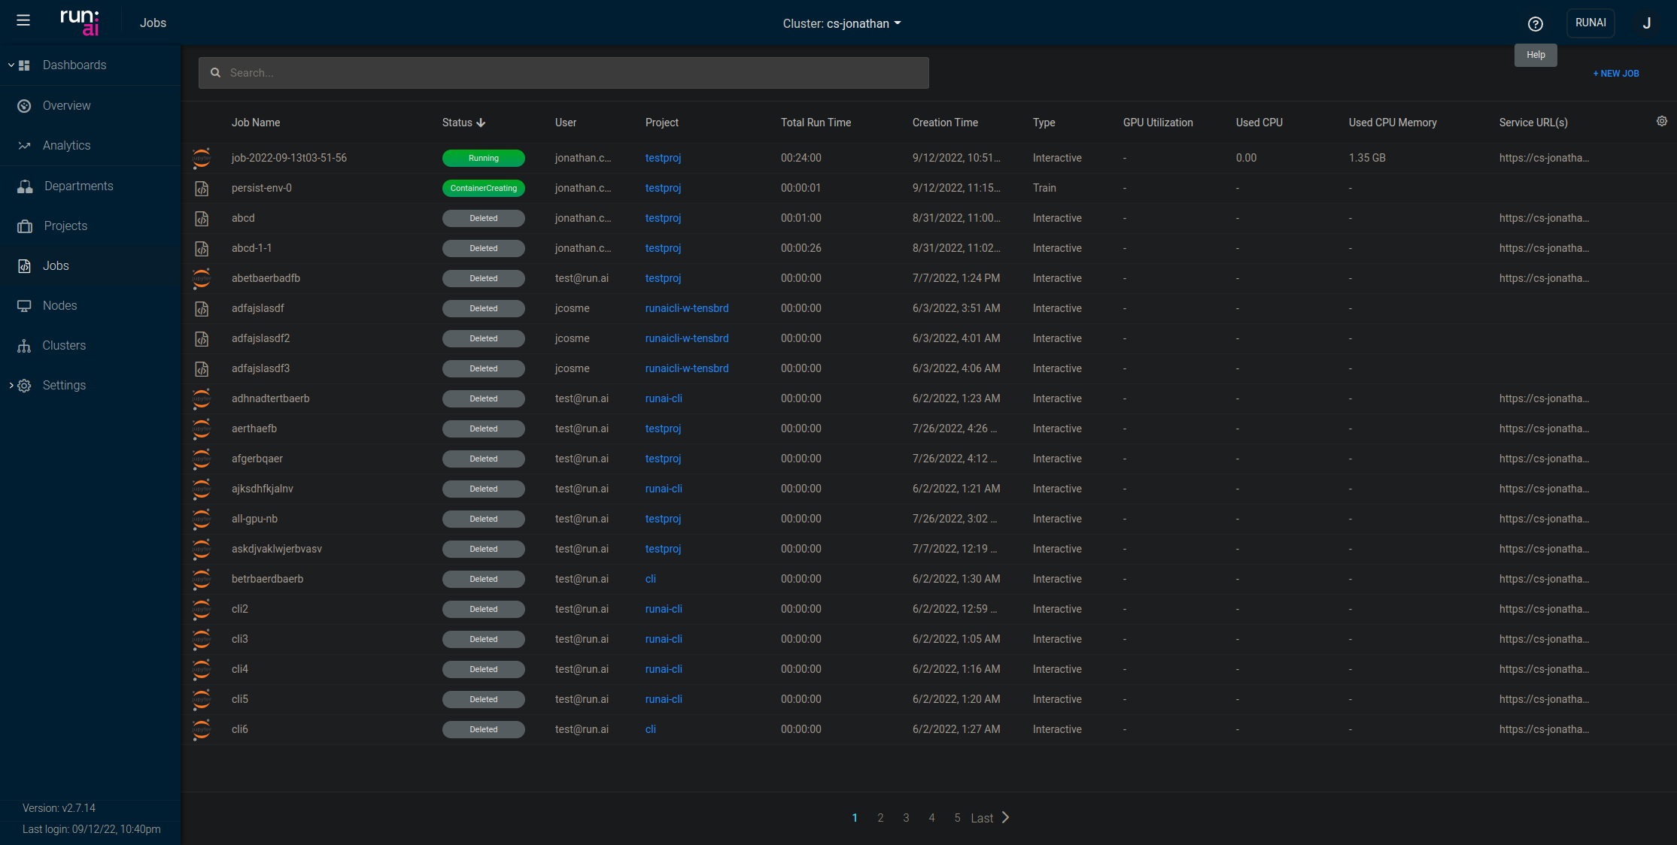
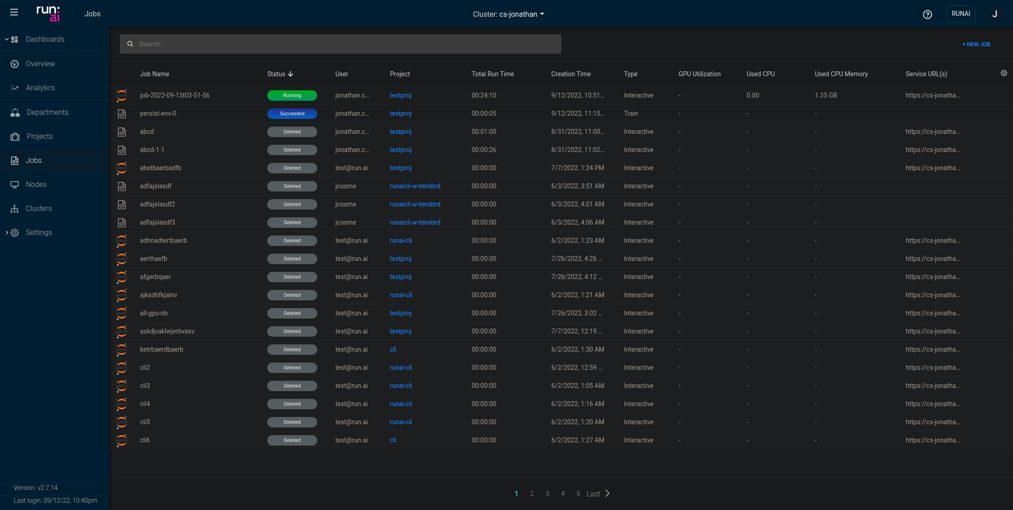
Step 4
Test the environment
4.1 Run the runai CLI command. You should see a new job in the job list
4.3 View the output of the jobs in the Logs tab
4.2 Wait for the job status to switch to ‘Succeeded’

Slide 21
Thank you!

